Slide 1
Advanced Design Methods (MDO, KBE) AE4233
Dr.ir. G. La Rocca
Dr.ir. H.A. Visser
Ir. D. Steenhuizen
Dr. A. Elham
Flight Performance & Propulsion Group (FPP)
Decomposition and coordination
Multidisciplinary Optimization strategies

Slide 2
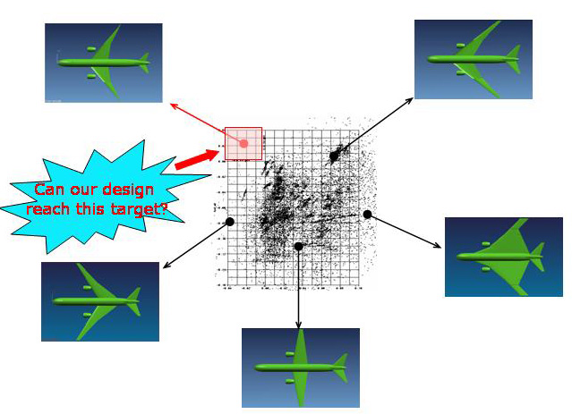
In lecture 1, we learnt that….
Design is essentially a search problem
The search takes place in a solution space (domain)
The feasible part of the solution space is bounded by constraints (set by one or more disciplines)
The search is guided by an objective (depending by one or more disciplines)

Slide 3
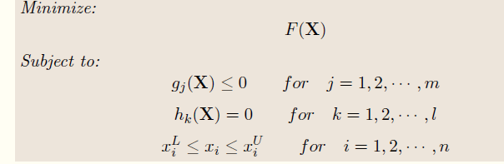
In lecture 1, we learnt that….
…this search process can be formulated as a non linear optimization problem, as follows:
Where:
X = (x₁, x₂, …x_{n})^{T} is the design vector, consisting of all the design variables x_{i}
F is the objective and is a scalar value
g_{i} are the inequality constraints
h_{k} are the equality constraints
x_{i}^{L}, x_{i}^{U} are bounds for the design variables

Slide 4
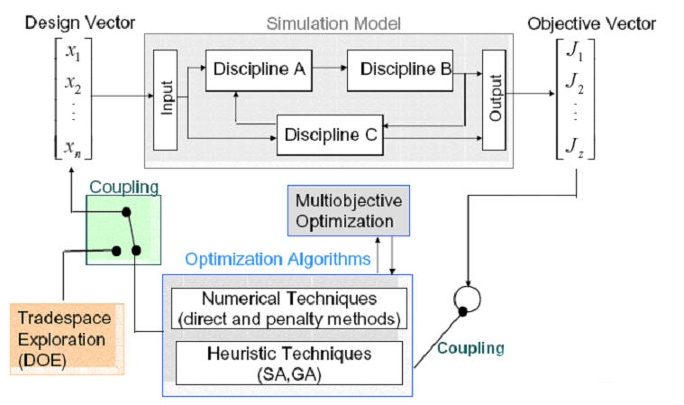
In lecture 1, we learnt that….
…this is the general structure of an MDO systems:
(Parameterization in Lecture 1)
(Numerical and Heuristics techniques in Lecture 2)

Slide 5
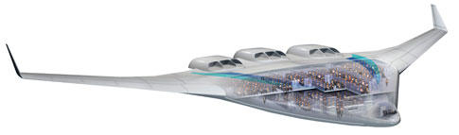
The problem of scale and complexity
Applying MDO to a complete aircraft is not straightforward as solving a non linear optimization problem for a well defined mathematical problem.
Because of:
the generally large scale of the problem
the high level of complexity of the product
It is difficult or impossible to discover, understand and account for all relations; hence:
It is difficult to meet design requirements
It is difficult to benefit from synergy
A direct approach is impossible! We need to decompose the problem and use adequate strategies to re-integrate it

Slide 6
Contents of this lecture
Decomposition and coordination
Or: How to analyse a complex system
Multidisciplinary Optimization strategies
Or: How to organize the architecture of the computational system in order to efficiently and effectively perform optimization

Slide 7
Contents of this lecture
Today’s focus

Slide 8
Decomposition of a complex process/product
Decomposition
Why and how to break down the system into aspects and sub systems
Couplings between aspects and sub systems
Design Structure Matrix (DSM)

Slide 9
Complex System Analysis
1

Slide 10
Complex System Analysis
1

Slide 11
Complex system analysis
Decentralization by decomposition or partitioning of problem into sub-problems
Need for decomposition techniques
Need for coordination of the process
Notes:
Decomposition non-trivial since not all interactions are known and coordination requires insight in these.
Insight in interaction between system elements is necessary

Slide 12
Decomposition of the system
Subsystems
Modules
Components
Disciplines
Viewpoints
Object based
Aspect based
Notes:
Decomposing of a system into a collection of sub-systems is not an exact science. Often a decomposition is based on practical considerations of the design-team involved.
As various domain experts are likely to be present in a design-team, work is divided up so each expert can work on his own aspect of expertise (e.g. aerodynamics, structures, propulsion, operations, etc.)

Slide 13
Decomposition of the system
Hybrid decomposition
Object based
 | Fuselage | Wing | Empennage | Engine
Aerodynamics
Mechanics
Control
Propulsion
…
Aspect based

Slide 14
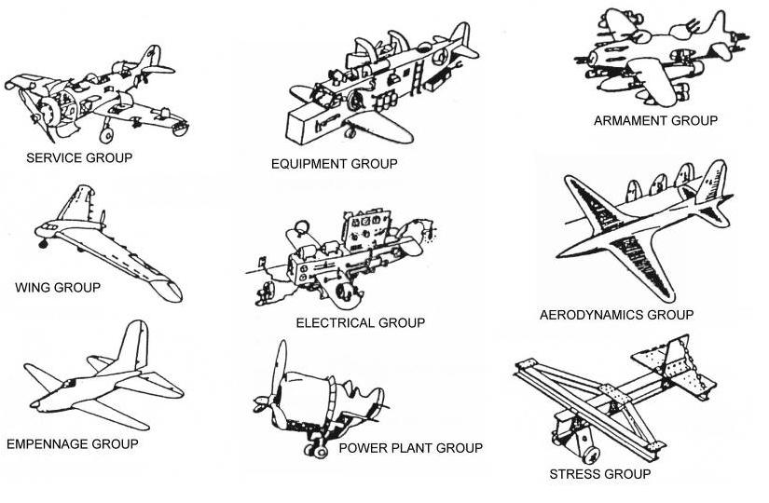
Decomposition and optimization without coupling

Slide 15
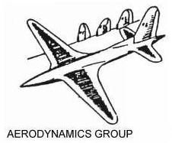
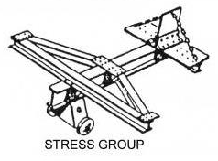
Multidisciplinary Optimization: finding the right* balance
*..but what is right?

Slide 16
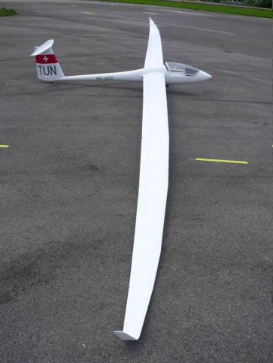
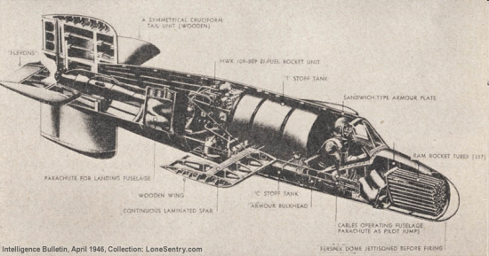
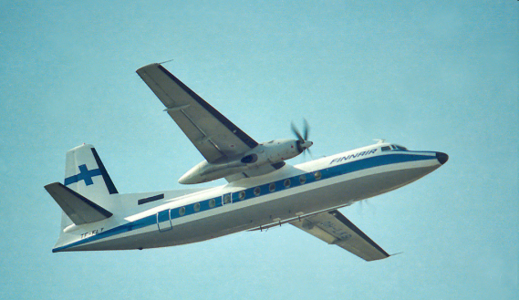
Multidisciplinary Optimization: finding the right balance
Very low AR for low wing weight
Very high AR for high L/D
A compromise solution

Slide 17



Multidisciplinary Optimization: finding the right* balance
Min{C_{D}/C_{L}(x)}
h_{i} < 0
gi < 0
Min{W(x)}
h_{i} < 0
g_{i} < 0
Min{a₁*C_{D}/C + a₂*W}
h_{i} < 0
g_{i} < 0
*= the solution that minimizes the set objective, while satisfying all constraints
Notes:
The coefficients a1 and a2 of the composed objective (so called weight factors), can be modified by the designers to privilege one of the disciplines and perform some trade off studies. E.g., how the optimum design would change when privileging aerodynamic efficiency over structural weight?

Slide 18
Reflecting on decomposition
Decomposition is required to be able to analyse the complex system
Often a limited set of characteristic sub or aspect systems is used to describe the system.
Decomposition is non-unique
Decomposition allows the individual treatment of sub and aspect systems
However, a system is a coupled set of these views and should be treated accordingly

Slide 19
Coupling of subsystems
Coupling is defined as “the measure of the strength of association by a connection from a (sub)system to another [Stevens et al. 1974]”
Coupling is determined by the followings:
Quantity, large amounts of data are interchanged
Quality, small amount of important data is interchanged
Sensitivity, reaction of the subsystem to a change in input

Slide 20
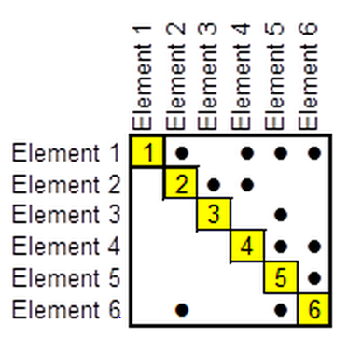
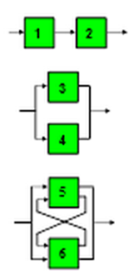
Visual aid to identify and represent couplings: The Design Structure Matrix (DSM)
The Design Structure Matrix provides a highly compact, easily scalable, and intuitively readable representation of a system architecture.
decoupled
uncoupled
coupled
Notes:
Text based on: http://www.dsmweb.org/en/understand-dsm/technical-dsm-tutorial0/reading-a-dsm.html
The slide above shows a simple DSM model of a system with six elements. The cells along the diagonal of the matrix represent the system elements.
To keep the matrix diagram compact, the full names of the elements are often listed to the left of the rows (and sometimes also above in the columns) rather than in the diagonal cells. It is also easy to think of each diagonal cell as potentially having inputs entering from its top and bottom and outputs leaving from its left and right sides.
The sources and destinations of these input and output interactions are identified by marks in the off-diagonal cells. These marks can also be substituted by the explicit list of the input/output information that is exchanged, or other attributes characterizing the interactions (e.g., number of interactions and/or the importance, impact, or strength, etc..—which might be represented by using one or more numerical values, symbols, shadings, or colors instead of just the binary marks in each of the off-diagonal cells)
Examining any row in the matrix reveals all of the outputs from the element in that row (which are inputs to other elements). Looking down any column of the matrix shows all of the inputs to the element in that column (which are outputs from other elements). For example, in the figure below, reading across row 2, we see that element 2 provides outputs to elements 3 and 4. Reading down column 5, we see that element 5 receives inputs from elements 1, 3, 4 and 6.
To the right of the DSM above are node-directed link diagram equivalents of portions of the DSM. Note that elements 1 and 2 form a linear chain or sequence, while elements 3 and 4 are independent, and elements 5 and 6 are interdependent or coupled.
Many DSM resources use the opposite convention of what shown in this slide, i.e., the transpose of the matrix, with an element’s inputs shown in its row and its outputs shown in its column. It is advisable to include some arrows for clarity!

Slide 21
System classification based on coupling direction
Coupled; Feed back and feed forward
Iterations between sub systems for converged result
Decoupled; Feed forward
Sequential computation of sub systems
Uncoupled; Neither feed forward nor feed back
Parallel processing
Increasing computation Speed

Slide 22
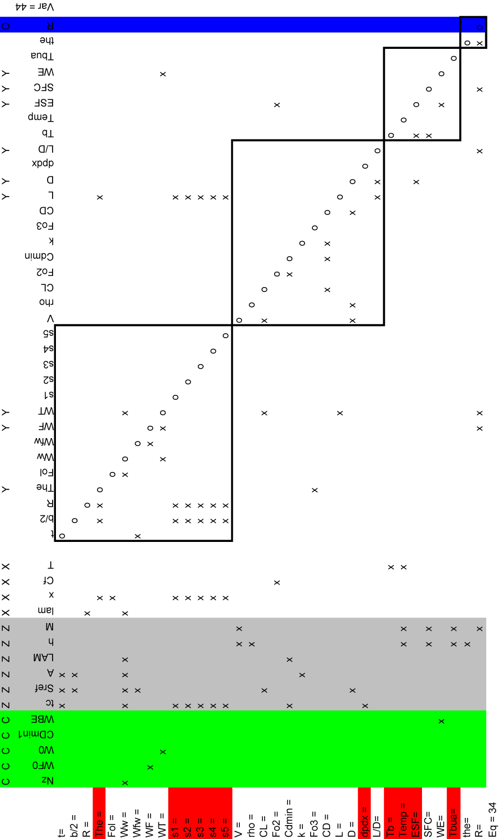
Example of complex DSM
What do you want to tell about this? Slide.
I suggest you add some text in the notes space below.
This is a DSM with a further division in dependent and dependent variables, relations…you might want to discuss why/how this differs from the previous DSM examples
Independent
Dependent
Relations
e.g.
Aspect
systems
Source NASA TM-1998-208715

Slide 23
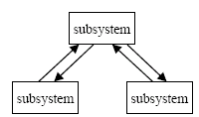
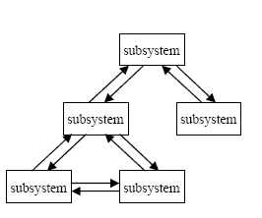
System classification based on coupling architecture
Hierarchic
Hybrid
Non-hierarchic
Increasing computation Speed

Slide 24
Benefits of understanding coupling
Increase the speed by rearranging sub or aspect systems in the computation
e.g. by maximizing the number of feed forward relations.
Tearing coupling relations can uncouple system (model) structure
Allow for parallel processing, increasing computation speed

Slide 25
Tearing of coupling relations
Tearing of a coupling relation can decouple the system or even uncouple the (sub)systems.
coupled
decoupled
uncoupled
Tearing a coupling relation however implies some form of coordination to ensure a consistent system
Coordination is managing dependencies between activities [Malone and Crowston, 1994]

Slide 26

Example
System decomposed according to disciplines
Aero.
(wing area, aspect ratio)
S,A,W
L/D (aerodynamic efficiency)
Strength
S,A,L/D
W (weight)
Perf.
L/D,W
R (range)
Goal: Maximize R by modifying the design variables S,A

Slide 27
Example
S,A
S,A
Design variables
Aero.
L,D
L/D
Strength
W
W
Objective
Generation of the DSM to visualize the system couplings
Perf.
R

Slide 28
Example
S,A
S,A
Aero.
L,D
L/D
Strength
W
W
Perf.
R
Tearing of coupling to speed up / simplify calculation

Slide 29
Example
Preferred uncoupled system
Optimizer
S,A
, W*
S,A, L*, D*
(L/D)*,W*
Tearing of couplings requires introduction of surrogate variables
Starred variables are the surrogate variables
Strength
L/D
W
R
Target state

Slide 30
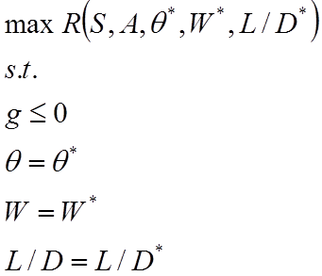
Example
Introduced surrogate variables
Additional equality constraints
The mathematical definition of the problem is now different!!

Slide 31
To recap
Multiple methods exist for organizing the disciplinary models to improve computational efficiency
Change the order of treatment (to minimize feedback loops)
Tearing allows decoupling but introduces additional variables and constraints, hence change the definition of the mathematical problem to be solved
The Design Structure Matrix provides a powerful visual aid to investigate the couplings

Slide 32
Contents of this lecture
Decomposition and coordination
Or: How to analyse a complex system
Multidisciplinary Optimization strategies
Or: How to organize the architecture of the computational system in order to efficiently and effectively perform optimization

Slide 33
Different strategies
Centralized or distributed decision authority
Single level approach
Multi level approach
Optimizer responsible for coordination
Analysis consistency provided at subsystem level
Evaluation consistency provided by optimizer

Slide 34
Single level optimization strategies
MultiDiscipline Feasible (MDF)
[Alternative designations]
All-in-One (AIO)
Fully Integrated Optimization (FIO)
Individual Discipline Feasible (IDF)
[Alternative designations]
Distributed Analysis Optimization (DAO)
All at Once (AAO)
[Alternative designations]
Simultaneous Analysis and Design (SAND)
Optimization based decomposition (OBD)
Feasibility/Consistency coordination at higher level/ optimizer

Slide 35
MultiDiscipline Feasible (MDF)
Notes:
SO – System Optimizer
SC – System Coordinator
DA – Discipline Analyzer
DE – Discipline Evaluator
DC – Discipline Coordinator
X_{s} – Design variables used in overall system
X₁ – Design variables used for discipline 1
X₂ – Design variables used for discipline 2

Slide 36
MultiDiscipline Feasible
DC1 is responsible for coordinating local consistency of this Discipline D1
DC1 will iterate DE1 until local Discipline residual r₁ becomes 0; i.e consistency
This block is also termed a Discipline Analyser (DA)

Slide 37
MultiDiscipline Feasible
SC will iterate all DA’s until inter-system residuals r₁₂ and r₂₁ become 0; i.e. overall system consistency
Overall SC is responsible for ensuring consistency between all involved Disciplines

Slide 38
MultiDiscipline Feasible
SO does not handle consistency coordination at all; this is delegated to SC and DA’s
SO is only concerned with finding design vector X that renders the system optimal (f₁, f₂) and feasible (g₁, g₂)
Note the clear division in the handling of design variables X by the SO and the discipline state variables S / S* by SC and DC’s

Slide 39
Individual Discipline Feasible
Optimization structure is simplified by taking away the SC
However, inter-system consistency now becomes the responsibility of the SO. Therefore the inter-discipline consistency constraints (r₁₂, r₂₁ ) are included in the optimization problem formulation, as well as state variable surrogates S*

Slide 40
Individual Discipline Feasible
DA’s remain unchanged

Slide 41
Individual Discipline Feasible
System state variables S are now treated in the same way as design variables X by the SO. They have become “design” variables w.r.t. the optimizer
SO now also handles inter-system residuals and state variable surrogates

Slide 42
All At Once
One step further: also the individual DC’s are removed
So, responsibility for individual Discipline consistency is also moved to the overall SO.
Hence, individual discipline consistency constraints (r₁, r₂) are also included in the optimization problem formulation

Slide 43
All At Once
SO is now responsible for all individual and inter-discipline consistencies
SO now also handles individual discipline residuals

Slide 44
Example problem
Discipline 3
Discipline 1
Discipline 2
Source: AIAA 2004-4537

Slide 45
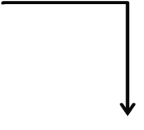
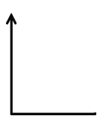
Example DSM (MDF)
SO
 | SC

Slide 46
Example DSM (MDF)
SO
 | SC
LOOP, stop if y_{j,i+1} - y_{j,i} < ε

Slide 47
Example DSM (IDF=AAO)
SO

Slide 48
Example DSM (IDF=AAO)
SO
2 additional constraints and
more variables to handle,
But no more loop

Slide 49
Different strategies
Centralized or distributed decision authority
Single level approach
Multi level approach
Optimizer responsible for coordination
Analysis consistency provided at subsystem level
Evaluation consistency provided by optimizer

Slide 50
Multilevel optimization strategies
Reasons for multilevel approach;
Discipline experts control local optimization
Available tools can be used in parallel
Examples;
Concurrent SubSpace Optimization (CSSO)
Collaborative optimization (CO)
Bi-level integrated system synthesis (BLISS)

Slide 51
Collaborative optimization
System level optimizer sets targets for the subsystems
Sub systems try to minimize the difference of target and actual values, while satisfying subsystem constraints

Slide 52
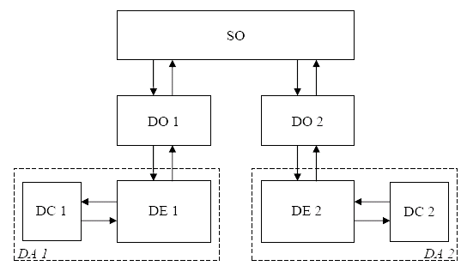
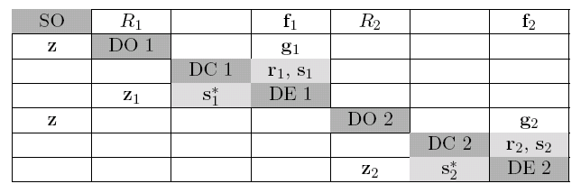
CO, mathematically

Slide 53
Example
S,A
S,A
Maximize R
by modifying S,A
Aero.
L/D
L/D
Strength
W
θ, W
Perf.
R

Slide 54
Example revisited (CO) (2)

Slide 55
Example 2, CO
SubSystem
Level
System
Level
Overall constraints are delegated down and divided among the lower level optimizers

Slide 56
Example revisited
Optimizer
S,A
θ*, W*
S,A
L/D*,W*
What kind of MDO scheme
could be implemented here ?
Strength
L/D
θ
W
R
Objective state [X S]

Slide 57
Conclusion
The multiple disciplinary models allow for various strategies to tackle and decompose the optimization problem
For the single level approach 3 basic approaches exist based on where consistency is achieved
Each evaluation of the system (MDF)
In each disciplinary model and system consistency when the constraints are satisfied (SDF)
When the constraints are satisfied (AAO)
For the multilevel approaches at least two optimizations are performed. This decomposes the optimization load as well
Multiple approaches exist, the “best” approach depends on the problem at hand as well as the organization of the design team

Slide 58
Overall Summary
In order to analyse complex systems efficiently
The design space can be parameterized to capture all feasible shapes in one model (and at the same time limit the analysis to these feasible shapes)
To be able to analyse the complex system the problem needs to be decomposed into multiple sub-problems, this however directly implies some form of coordination is required.
To optimize the design with respect to the objective function, several strategies can be employed. Single level as well as Multi-level optimization techniques are available to reduce computation time.

